Slide 1



SECURE 2.0 Act of 2022
2.0
More retirement help for all Americans
Participant Communications

Slide 2
Provision Timeline
Mandatory Provisions
Q1 2023
Q2 2023
Q3 2023
Q4 2023
Q1 2024
Q2 2024
Q3 2024
Q4 2024
2025
Increase RMD Age Provision 107
Adding ROTH Source Acct.^ Provision 603
Adding ROTH Source Acct.^ Provision 603
Long Term Part Time (LTPT) Provision 125
Optional Provisions
Q1 2023
Q2 2023
Q3 2023
Q4 2023
Q1 2024
Q2 2024
Q3 2024
Q4 2024
2025
In-Plan Emergency Savings
Provision 127
Auto Portability Provision 120
New Withdrawal Types
Provisions 115, 314, 311, 331, 334
Student Loan Payments
Provision 110
Higher Catch-Up
Provision 109
NOTE: Timelines based on launch dates.
^ Implementation of Roth Catch-Up provision impacting participants aged 50 and over has been delayed to January 1, 2026

Slide 3


SECURE 2.0
Required changes for plan sponsors*
Further increase in the Required Minimum Distribution age
Certain catch-up contributions required to be Roth
Further expansion of eligibility
to long-term, part-time workers
Required auto-enrollment for new DC plans
Annual paper benefit statement
Plan sponsors must ensure compliance with these provisions
Notes:
Taken from 1071484.1.0

Slide 4
SECURE 2.0
Optional changes for plan sponsors
Student loan payments match
Additional catch-up contribution opportunities
Matching and non-elective
contributions could be Roth
Increase in cash-out limit
Self-certification of hardship withdrawals
Automatic portability*
Eliminate disclosures for eligible unenrolled participants
In-plan emergency savings accounts
Plan sponsors will also need to consider whether to adopt these provisions
Notes:
Taken from 1071484.1.0

Slide 5

Guiding our participant strategy
Tailored approach for
each provision
Balancing general education needs with a timely, actionable experience
Grounded in participant feedback to provide simple solutions that enable employees to engage with the help they need, when they need it.

Slide 6

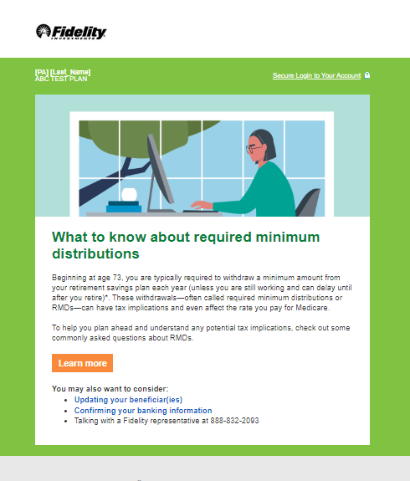
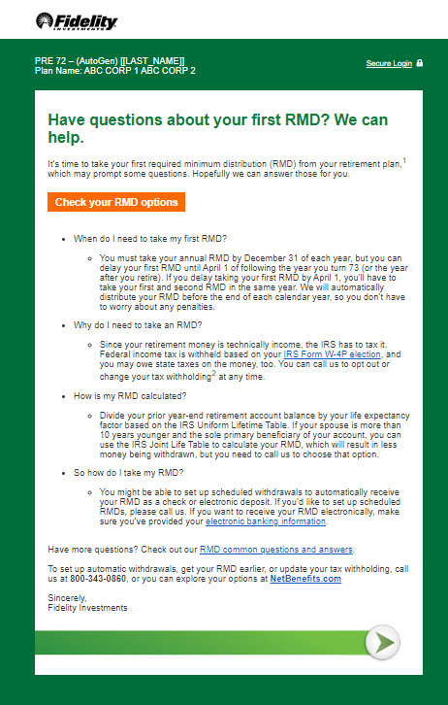
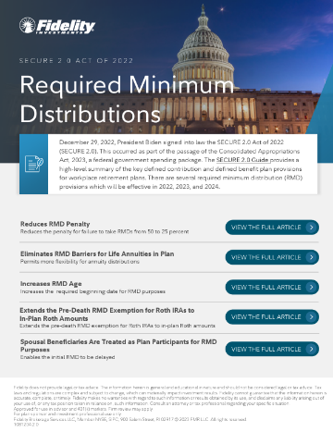
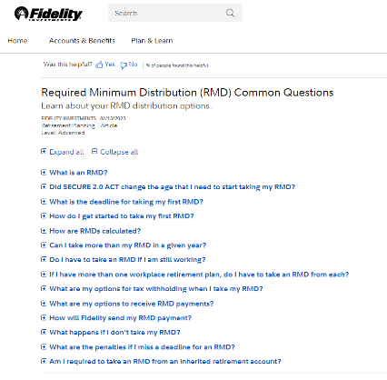

Increase to RMD Age
Mandatory Provision 107
Launched Q1 2023
Revised and refreshed relevant marketing campaigns to address age increase:
Initial year RMD communication
RMD age-based trigger
NetBenefits content, including articles and
virtual assistant content , FAQ
  RMD FAQs
  4 Reasons to Consolidate
  5 Important Rollover Questions
  Traditional or Roth IRA, or Both?
  What's ahead for your RMDs
  Explore options for your retirement savings: I’m retired or planning to retire

Slide 7
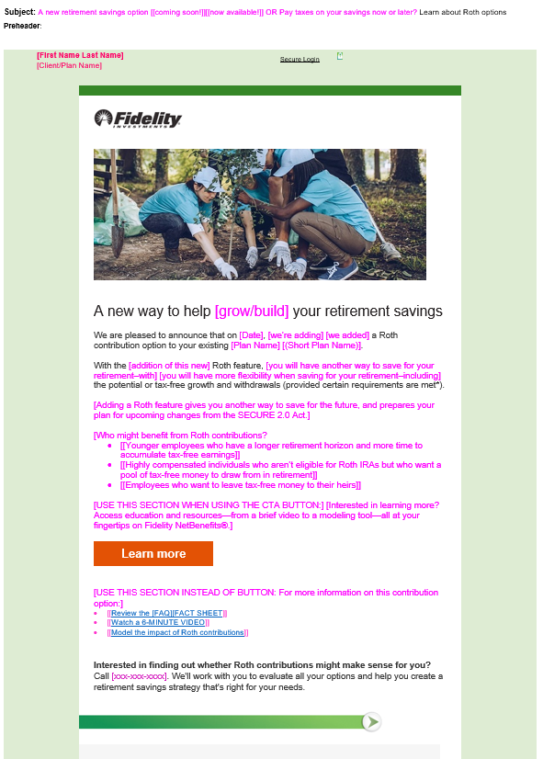
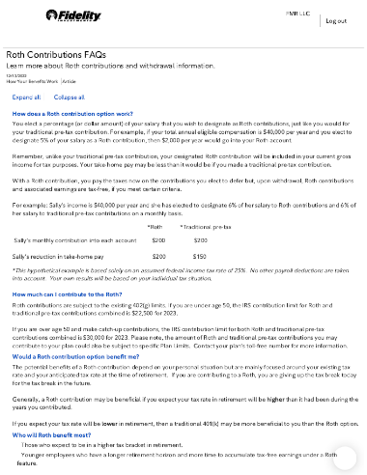
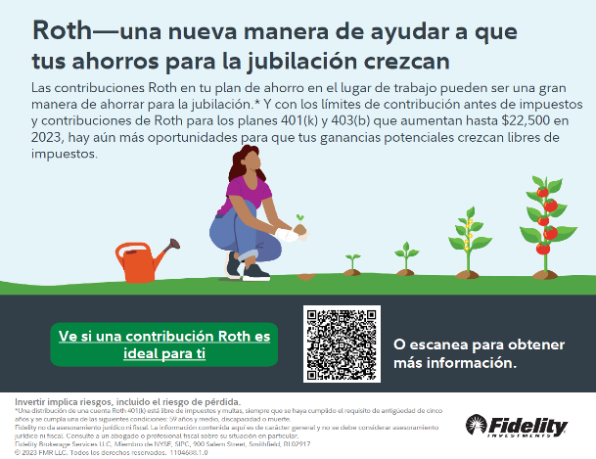
Adding a Roth source account
Mandatory Provision 603^
Launched Q4 2023
Under provision 603 , participants aged 50+ with wages over $145,000 in the previous year must make catch-up contributions on a Roth basis.
With the effective date being pushed to January 2026, plan sponsors can decide when a Roth option is added to their plans.
Dedicated Toolkit
Continuing with best-in-class support model
Updated emails with SECURE-specific variable language
Infographics and digital signage available in English and Spanish
Brainshark video: Roth vs. Traditional pre-tax contributions
Updates to all existing Roth fact sheets, articles, enrollment guide language
^ Implementation of Roth Catch-Up provision impacting participants aged 50 and over has been delayed to January 1, 2026

Slide 8
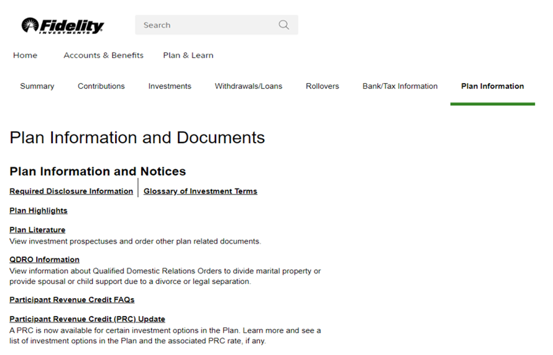
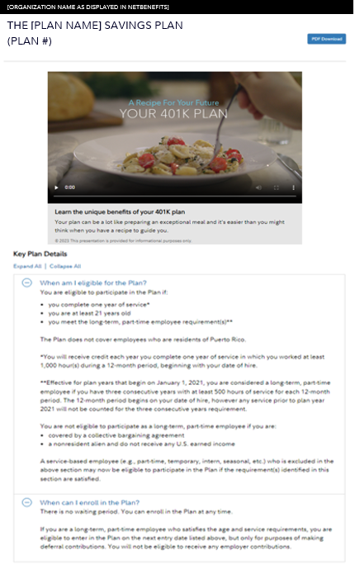
Long-Term Part-Time (LTPT)
Mandatory Provision 125
Launched Q1 2024
Beginning January 1, 2024, eligible long-term part-time employees can enroll and contribute to their 401(k) plan
Updates to new eligibility rules will be reflected on plan information and highlights*
  Refreshed NetBenefits plan highlights page for Core plans
  Upper market plans will require plan sponsor direction*
  See the LTPT Guide for further details
*Content updates to plan highlights will be made for all core market plans. Upper market plans will require plan sponsor direction to update

Slide 9
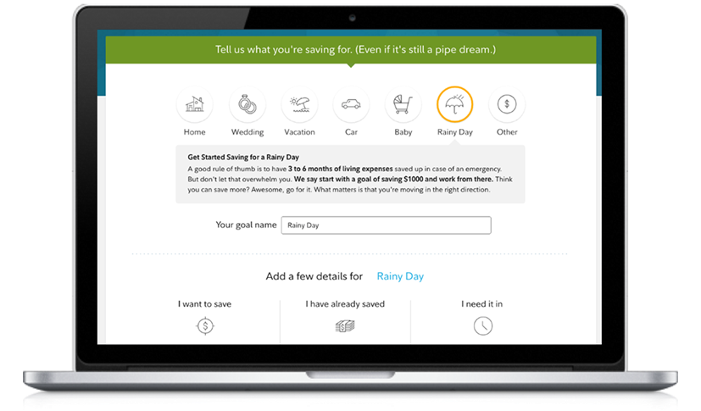
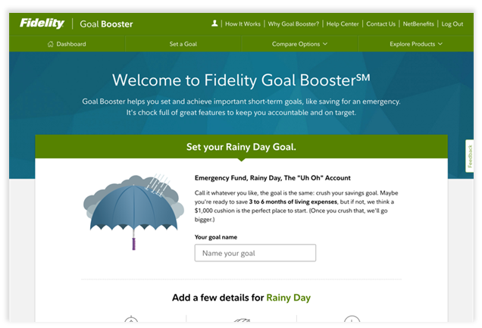

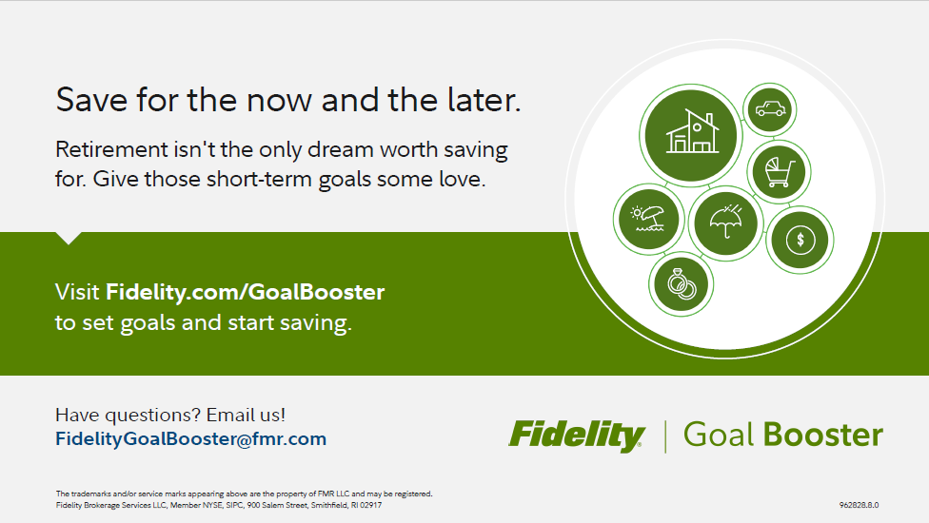

In-Plan Emergency Savings Accounts
Optional Provision 127
Launched Q2 2023
Beginning in 2024, employers will have the option to offer their employees pension-linked emergency savings
Fidelity has decided to provide an out-of-plan solution, Fidelity Goal Booster^{SM *}
A hybrid solution outside of the retirement plan that is in collaboration with the plan sponsors
Provides participants a vehicle to save for short-term goals without using employer-sponsored plan
Dedicated toolkit
Focused on educating participants on Goal Booster through:
Videos: Goal Booster Explainer, Emergency Savings, How You Money
Digital and printable materials (banners, posters, etc.)
Part of the existing emergency savings options
Informational website promoting Goal Booster
Future State:
Continued expansion of the Goal Booster Payroll functionality
* Reminder if you have clients asking, any employer with Financial Wellness can turn on Goal Booster

Slide 10

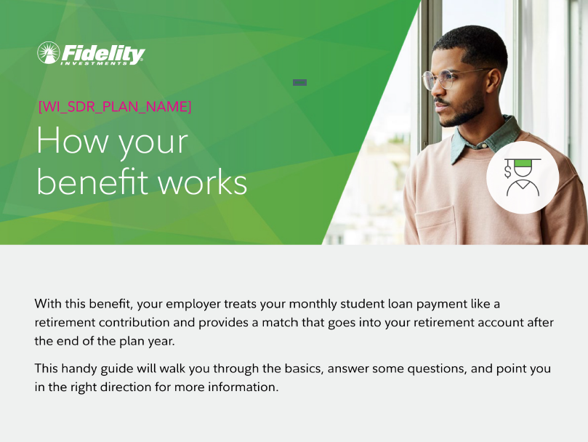
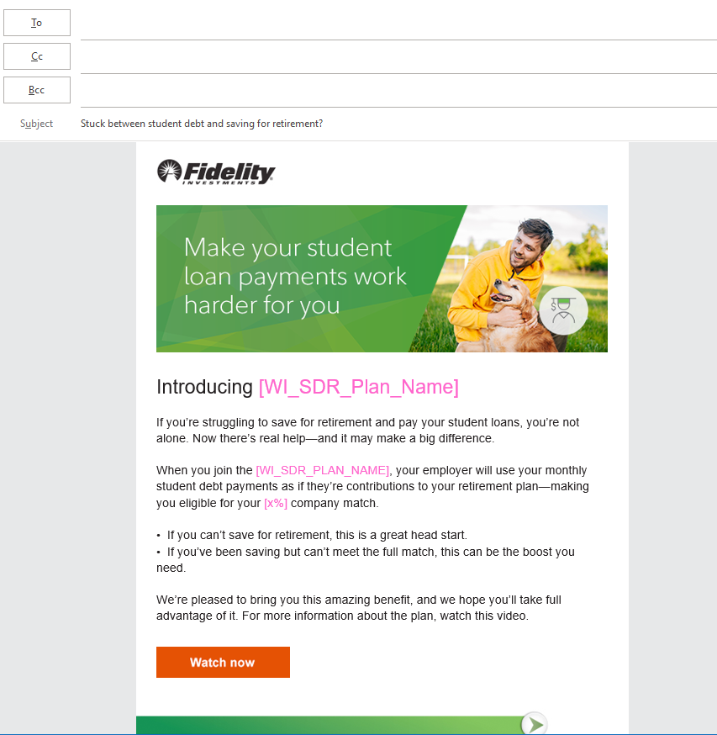

Student Loan Payments
Optional Provision 110
Launched Q3 2023
Beginning in 2024, employers can offer the Student Debt Retirement (SDR) benefit to their employees
Student Debt payments resumed in October 2023
Dedicated Toolkit
A suite of materials to help launch, promote, and leverage the Student Debt Retirement benefit
Videos: Benefit overview
Customizable emails
Digital signage, flyers, etc.
Other Student Debt resources are available
In coming months, 40+ clients are slated for Student Debt Retirement onboarding – that’s over 800,000 eligible participants.

Slide 11
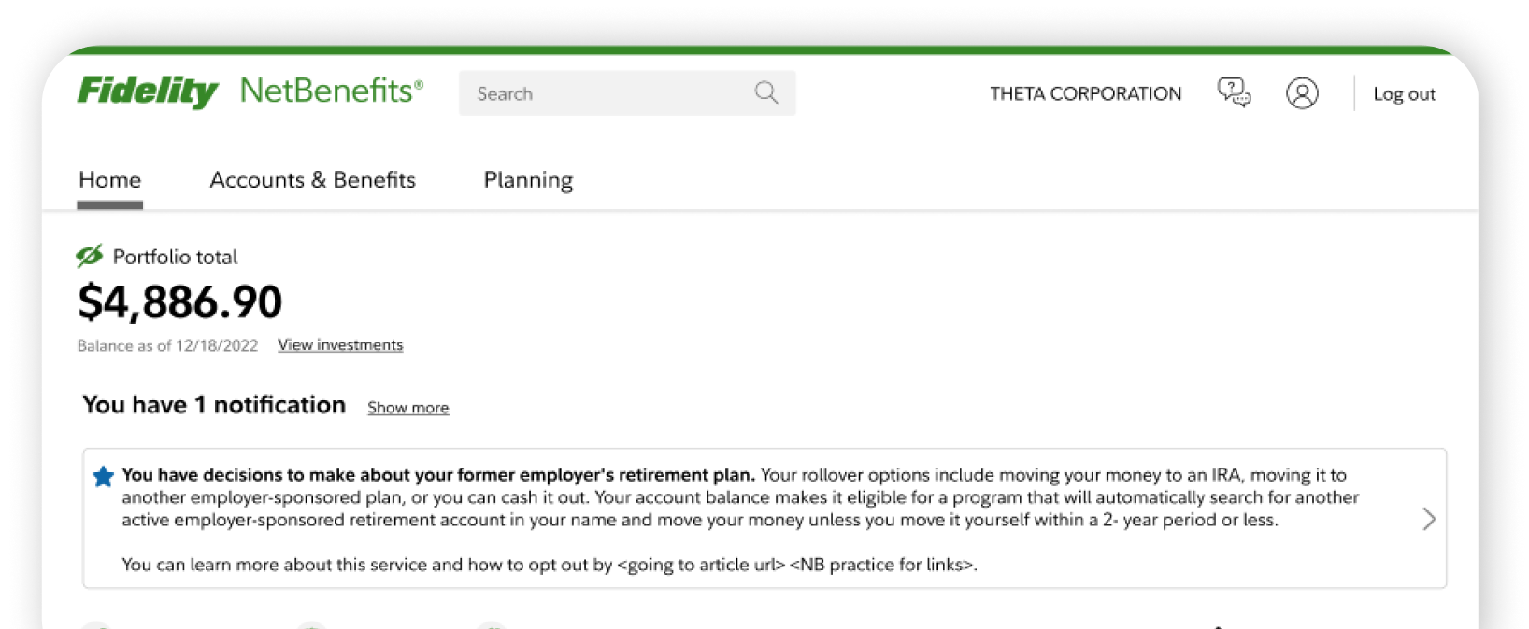
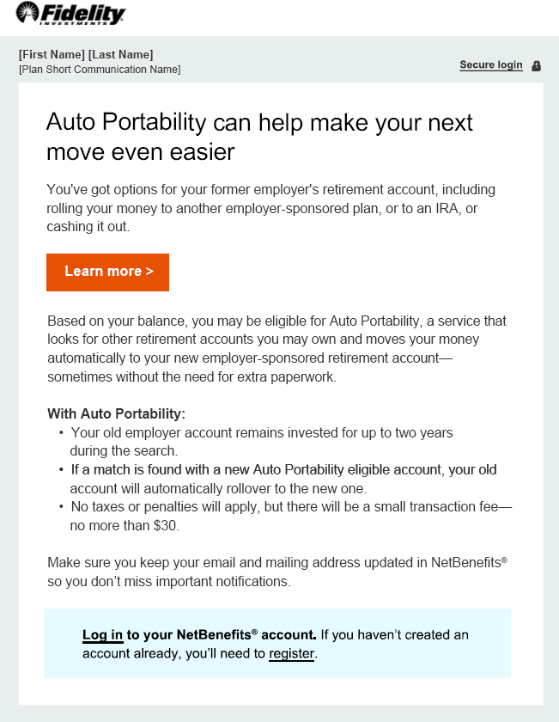
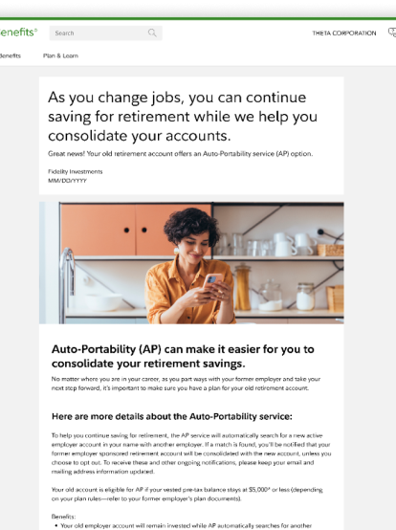
Auto Portability (AP)
Optional provision 120
Launched Q3 2023
Portability Services Network (PSN)‡ and Auto Portability
Industry-led opportunity to offer automatic rollovers of small balance retirement accounts from former to current employers – without tax consequences to employees. The process will be facilitated by the Portability Services Network (PSN).
Auto Portability helps America’s under-served and under-saved workers, especially people of color, women, and lower-income, and younger workers, improve their retirement outcomes.
Fidelity is educating eligible participants via:
NetBenefits homepage alert
Triggered regulatory communications upon termination
NetBenefits educational article
Additional resources planned throughout 2024
See the Auto Portability Plan Sponsor Overview for further details and adoption
Screenshots for illustrative purposes only
‡PSN is not affiliated with Fidelity Investments or its affiliates.
Notes:
For the first time, workplace retirement plan recordkeepers and Fidelity’s leadership and Retirement Clearinghouse (RCH) have partnered to create a consortium to accelerate the adoption of Auto Portability (AP).
Reference: https://www.dol.gov/newsroom/releases/ebsa/ebsa20240118#:~:text=The%20department's%20proposed%20rule%20would,to%20Internal%20Revenue%20Code%20section

Slide 12
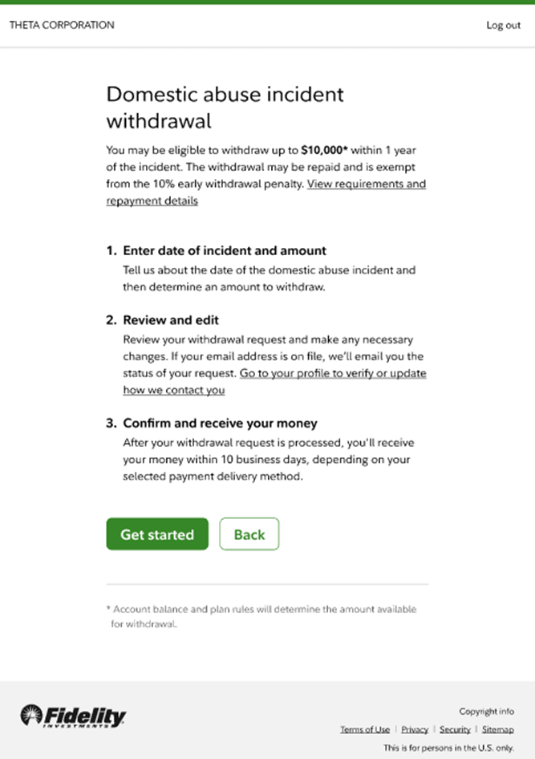
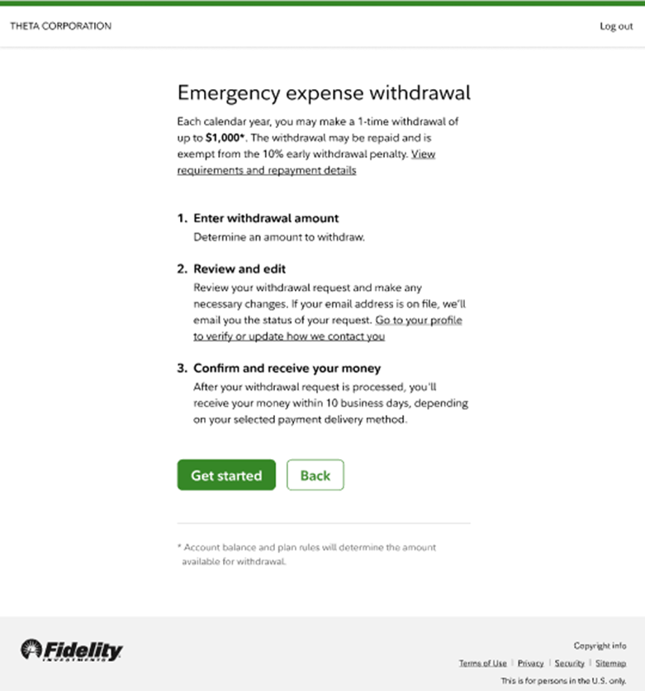
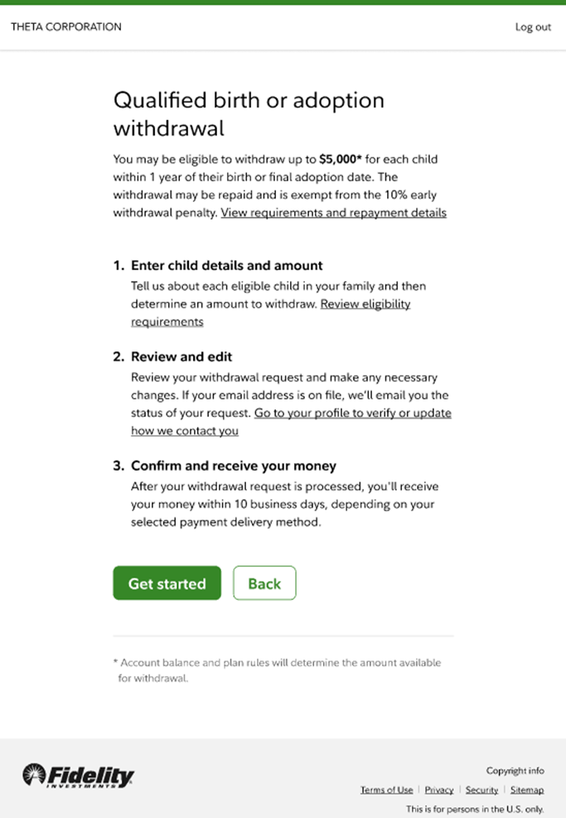
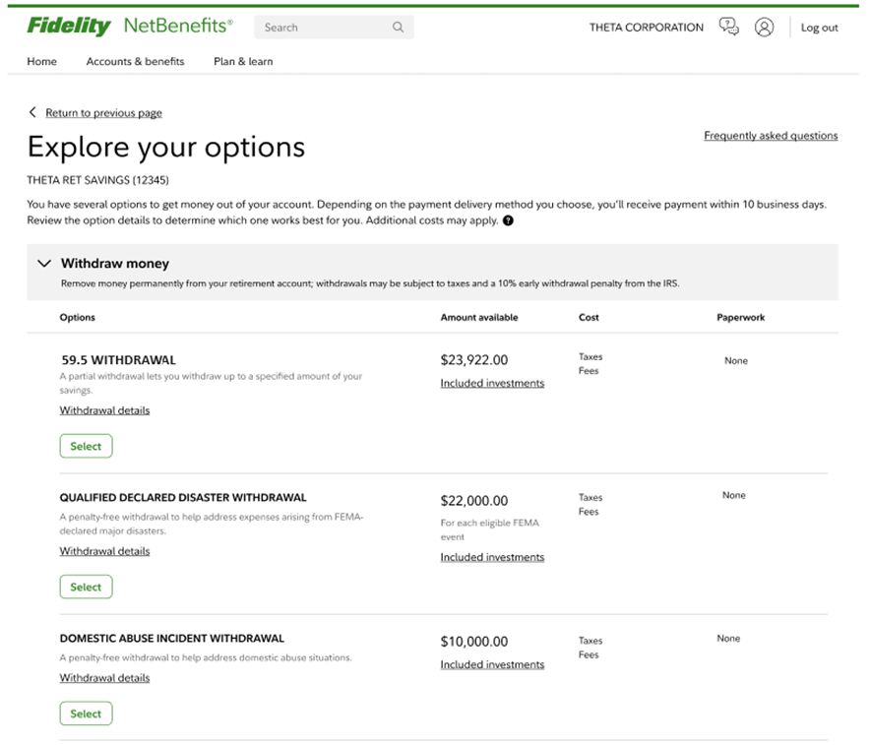
New withdrawal types
Optional Provisions 115, 314, 311, 331, 334
Launching 2H 2024
Beginning in 2024, employers can offer new optional withdrawal types as a benefit to their employees
  Withdrawal for emergency expenses (provision 115)
  Domestic abuse (provision 314)
  Qualified Birth or Adoption Distribution (SECURE 1.0 provision 311)
  Qualified declared disaster withdrawal (provision 331)
  Effective 2025: Long-term care (provision 334)
Updated NetBenefits experience – paperless digital options where possible
Customizable emails
An on-demand email featuring the 5 optional withdrawal types that Plan Sponsors can edit based on adoption

Slide 13
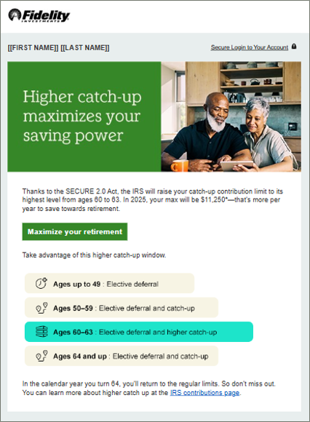
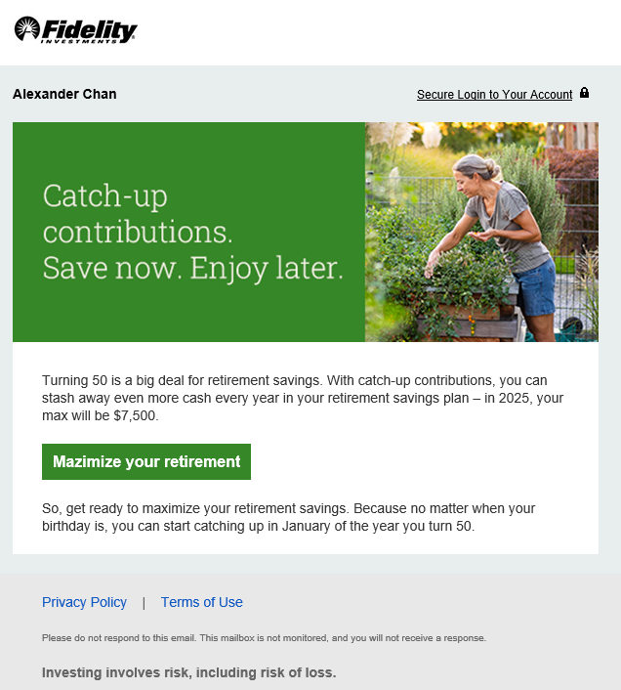
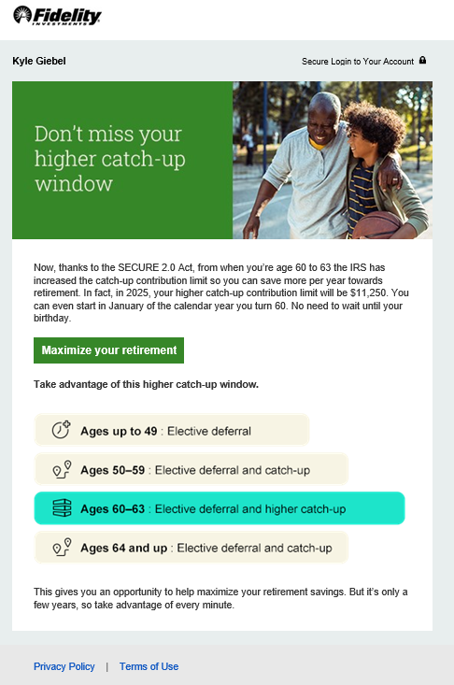
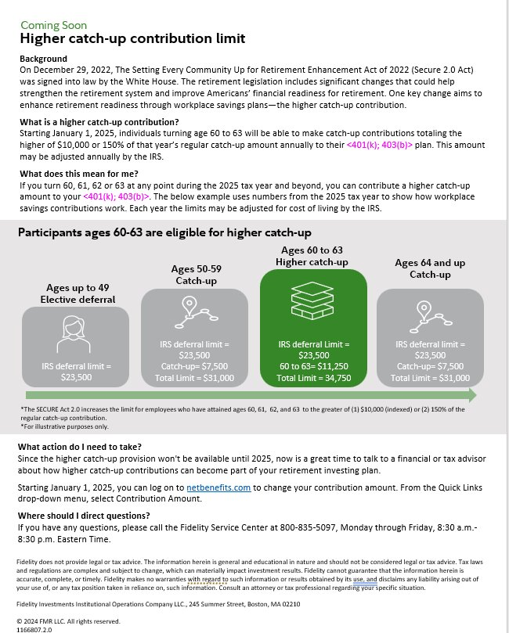
Higher Catch-Up Limit for Participants
Optional Provision 109
Launching Q4 2024
CommHub Code: HigherCatchUpLaunch
Starting January 1, 2025, individuals turning age 60 to 63 will be able to make catch-up contributions totaling the higher of $10,000 or 150% of that year’s regular catch-up amount annually to retirement plan.
Fidelity is educating eligible participants via:
  Fact Sheet
  NetBenefits On-Site & Mobile Messaging targeting participants turning 60-63 in the calendar year
  CommHub emails:
    Announcing Higher Catch-up benefit
    Educational Evergreen Template – Regular Catch-Up
    Educational Evergreen Template – Higher Catch-Up
A PSW Page has also been created with these materials.
CommHub Code: CatchUp
CommHub Code: HigherCatchUpEvergreen

Slide 14
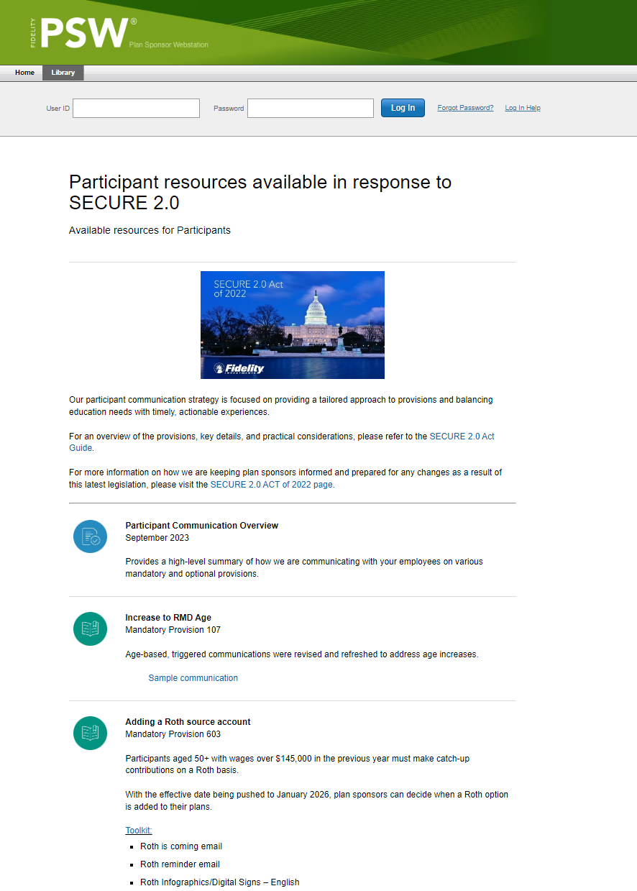
Additional Resources
Launched Q4 2023
PSW Participant Communications
  Complements the SECURE 2.0 Employer Communications page
  This PSW page features:
  Links to the Employer Communications page and the SECURE 2.0 Act Guide
  Links to Student Debt resources
  Links to Emergency Savings resources
  Provision-specific toolkits for
    RMD provision
    Roth provision

Slide 15
Disclosures
For plan sponsor and investment professional use only.
The Fidelity Investments and pyramid design logo is a registered service mark of FMR LLC.
Screenshots and graphics are for illustrative purposes only. Although some screenshots reflect currently available functionality, others may show concept designs being considered for future development. Fidelity reserves the right to modify or cancel any concept designs being displayed. This information should not be construed as an offer to sell or a solicitation to buy any product or service.
Fidelity Brokerage Services LLC, Member NYSE, SIPC, 900 Salem Street, Smithfield, RI 02917
© 2023 FMR LLC. All rights reserved.
1094009.4.0

Slide 16
Timeline
Mandatory
Optional

Slide 17
Timeline
2016
2017
2018
2019
2020
2021
2022
Increase RMD Age Provision 107 olessim nimusaeptia dis autem ilitium aliquamus
Impori dolessim nimusaeptia dis autem ilitium aliquamus
Impori dolessim nimusaeptia dis autem ilitium aliquamus
Impori dolessim nimusaeptia dis autem ilitium aliquamus
Impori dolessim nimusaeptia dis autem ilitium aliquamus
Impori dolessim nimusaeptia dis autem ilitium aliquamus
Impori dolessim nimusaeptia dis autem ilitium aliquamus
Impori dolessim nimusaeptia dis autem ilitium aliquamus
Impori dolessim nimusaeptia dis autem ilitium aliquamus
Optional

